Slide 1

Mystery, Ministry, and Me
3:1 – 13
Week 19
1 June 2022

Slide 2

Ephesians overview
In this chapter Paul reminds his readers of God’s grace that has been shown him regarding the revelation of the “mystery.” By reading what he had written earlier, they would understand how the “mystery” pertained to Gentiles becoming fellow heirs in Christ, and Paul felt privileged to preach among the Gentiles what for ages had been hidden.
Knowing that what he did was part of God’s eternal purpose in Christ to make His manifold wisdom known by the church, he asked his brethren not to be discouraged by any tribulations he experienced on their behalf (1-13).

Slide 3
Ephesians overview
The chapter also contains Paul's second prayer for the Ephesians. He prays for their enablement, that the Father would strengthen them by His Spirit, that Christ might dwell in their hearts through faith, that they be able to know the love of Christ which passes knowledge, and so be filled with all the fullness of God.
Paul concludes his prayer and this chapter by asserting that glory be given to God in the church by Jesus Christ for all eternity (14-21).

Slide 4

The Mystery, The Ministry, and Me

Slide 5
Ephesians 3:1 – 13
The Mystery, The Ministry, and Me
  A mystery once hidden, now revealed (1-7)
Interrupting himself, Paul makes mention of God’s grace (1-2).
That by revelation God made known to Paul the “mystery” (3-4).
A “mystery” once hidden, but now revealed (5).
The “mystery” involved the Gentiles (6).
Paul’s role as a minister of this “mystery” was a gift from God (7).

Slide 6
Ephesians 3:1 – 13
The Mystery, The Ministry, and Me
Paul’s task as a minister of this “mystery” (8-12)
To preach among the Gentiles the unsearchable riches of Christ (8).
To make all see what is the fellowship of the “mystery” (9-12).
Paul makes reference to himself “Me” (13).
Do not to be discouraged because of my sufferings for you (13)

Slide 7
Ephesians 3:1 – 13
The New Testament gives us three vivid pictures of what the church is. Each is found in Ephesians. Each differs from other biblical illustrations that describe the church. These show us not what the church is like, but what the church is.
Of course, we know that the church is people. Not organizations or buildings or programs, but people. The Greek word ecclesia means “congregation,” and more specifically a “called-out congregation.”
Those who have responded to God’s invitation in Christ are called out from humanity to fulfill all of mankind’s ancient dreams in a vital, new community. Each of us responds to that invitation individually, but once we respond, we are part of a great company.

Slide 8
Ephesians 3:1 – 13
It is important for us to realize that now our identity is to be found not in isolation but in and through the community of Christ’s church. We grow in our capacity to live as God’s people within this fellowship.
So it is vital to learn what the church is. Discovering the true nature of the church and learning to live as members is critical to our personal growth and fulfillment.
The Church: all believers are “members together of one body, and sharers together in the promise of Christ Jesus” (3:6). Here, Paul stresses the church’s unity, showing that each believer is linked to Christ and one another. This oneness is a truth we all must accept. Implicit in this portrait is the notion that the church lives only as she responds to her Head. Christ alone is Head of the church.

Slide 9
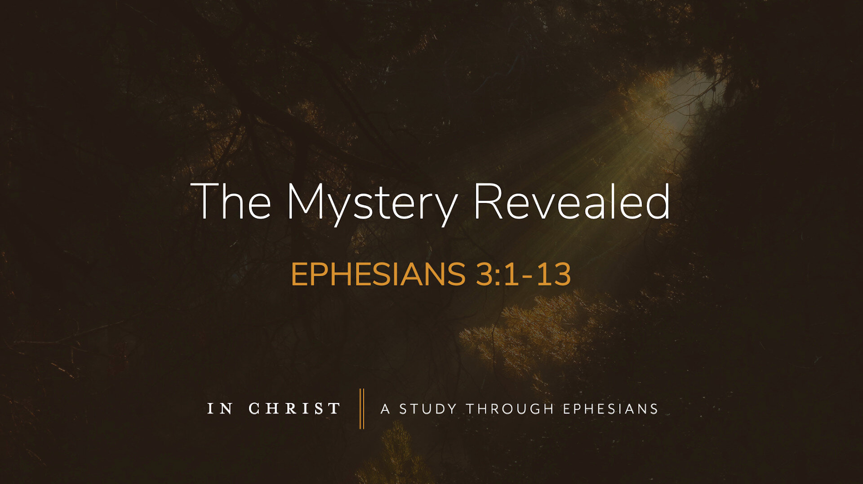

Slide 10
Ephesians 3:1 – 13
Paul now called the church a “mystery.”
What is this “mystery”? It is an insight made available to Christians which was not made clear in the Old Testament. The “mystery” here is the fact that the Gentiles would be “heirs together with Israel, members together of one body, and sharers together in the promise of Christ Jesus” (3:6).
While Isaiah and others had foretold that Gentiles would one day be saved, all thought theirs would be a subordinate position. No wonder Paul repeats and repeats in Ephesians the doctrine that the church is one.

Slide 11
Ephesians 3:1 – 13
Paul, as the Apostle to the Gentiles, had been called by God to reveal this unexpected aspect of God’s eternal plan. Paul reminded us that that plan expressed the “manifold” (that is, complex or multifaceted) plan of God.
God is at work in the church, doing far more than we may imagine. What is important for us however is to realize that “in Him [Christ] and through faith in Him we may approach God with freedom and confidence” (3:12).

Slide 12
Ephesians 3:1 – 7
¹For this reason I, Paul, the prisoner of Christ Jesus for the sake of you Gentiles — ²Surely you have heard about the administration of God’s grace that was given to me for you, ³that is, the mystery made known to me by revelation, as I have already written briefly. ⁴In reading this, then, you will be able to understand my insight into the mystery of Christ, ⁵which was not made known to people in other generations as it has now been revealed by the Spirit to God’s holy apostles and prophets. ⁶This mystery is that through the gospel the Gentiles are heirs together with Israel, members together of one body, and sharers together in the promise in Christ Jesus. ⁷I became a servant of this gospel by the gift of God’s grace given me through the working of his power.

Slide 13
Ephesians 3:1 – 7
You may have notice that even though 3:1-3 ends with a period, these verses are really a sentence fragment in English. This is because in the Greek text, Ephesians 3:1 and 3:14-21 actually represent Paul’s second prayer in the book of Ephesians, while 3:2-13 is one parenthetical run-on sentence explaining the “mystery” of the church.
Structurally, the entire chapter looks like this: “For this reason I, Paul, the prisoner of Christ Jesus for the sake of you Gentiles—[parenthetical explanation of the mystery of Paul’s ministry to the Gentiles]—for this reason I kneel before the Father . . .”

Slide 14
Ephesians 3:1 – 7
We will pick up the content of Paul’s prayer in the next lesson. In this lesson, let’s look more closely at Paul’s parenthetical digression. It may be a run-on sentence in Greek, but 3:2-13 is not the idle rambling of a man who had lost his train of thought. It’s the key to unlocking the mystery of God that Paul had been divinely commissioned to declare.
In fact, Paul’s bold stand for the truthfulness of this mystery was the reason he was in prison. When Paul wrote his letter, he was under house arrest in Rome (Acts 28). Why was he there? The Jews had accused him of being a rabble-rouse, a disturber of the peace, and the promoter of an illegal religion.

Slide 15
Ephesians 3:1 – 7
Paul’s big problems began in Jerusalem, where he was falsely accused by Jews from Asia of defiling the temple by bringing Gentiles into the inner court (Acts 21:27-31). In the midst of the ensuing riot, Roman soldiers actually rescued Paul from his Jewish attackers by arresting and chaining him (Acts 21:32-36).
When given an opportunity to address the crowd of Jews, Paul recounted his conversion experience on the road to Damascus (Acts 22:1-16). He then took his testimony a step further. He shared a vision he had of Jesus, who had explicitly instructed Paul to leave Jerusalem saying, “Go! For I will send you far away to the Gentiles” (Acts 22:21).

Slide 16
Ephesians 3:1 – 7
Upon hearing this, the Jewish crowd responded in rage: “Away with such a fellow from the earth, for he should not be allowed to live!” (Acts 22:22). So infuriated were the Jewish religious zealots over Paul’s preaching of the Jewish Messiah to the Gentiles that several Jews swore not to eat or drink until they had killed him (Acts 23:12-15).
Clearly, the Jews were unimpressed by Paul’s God-given mission to the Gentile church. Eventually, after several years of being shuffled around in the custody of the Roman government, Paul ended up under house arrest in Rome, having exercised his right as a Roman citizen to appeal his case to Caesar(Acts 25:11).

Slide 17
Ephesians 3:1 – 7
To the chagrin of Paul’s Jewish opponents, his message to the Gentiles never let up. While detained in Rome, he wrote four letters that continue to shape our lives to this day: Ephesians, Philippians, Colossians, and Philemon.
When Paul explores the heart of the new mystery for which he was in chains, we ought to pay close attention. He begins by calling his ministry to the Gentiles “the stewardship of God’s grace” (3:2). Paul had already explained in great detail the grace that saved believers, uniting them with Christ. This truth about the person and work of Jesus Christ had been made known to Paul by a revelation (3:3). Paul called it “the mystery.” A secret once concealed but now revealed.

Slide 18
Ephesians 3:1 – 7
Paul had been granted special insight into this “mystery of Christ” (3:4). In fact, the revelation of this mystery was completely new, unheard of prior to its unveiling to the New Testament apostles and prophets (3:5)—recipients of those foundational ministries established by Christ through the power of the Holy Spirit for the first generation of the church (2:20).
Previous generations had been told of a coming Messiah, but they had assumed He would be a Messiah for the Jews only. They had no idea that the salvation promised through their Davidic King would cross the boundaries of Israel to be offered to the Gentiles. What’s worse, the mystery involved a union of Jews and Gentiles in one body, making them “fellow partakers of the promise in Christ Jesus” (3:6).

Slide 19


Slide 20
Ephesians 3:1 – 7
Imagine yourself in the place of a proud first-century Jew. You expected the Messiah to come, raise up an army, wage the righteous wars of the Lord, drive out the Roman oppressors and any other foreign power and pagan influences, and restore temple worship to what God intended.
Then, during the messianic age, the Gentiles would stream to the mountain of the Lord to learn His Law—submitting to the Davidic King, the Law of Moses, and the people of Israel as God’s chosen nation of kings and priests (Isa 2:1-4; cf. Exod 19:5-6).

Slide 21
Ephesians 3:1 – 7
When Paul comes along preaching the gospel of God’s unconditional acceptance of Gentiles through the Jewish Messiah, you would have been not only surprised and offended, but downright disgusted! Paul preached that through Christ the Gentiles wouldn’t simply admire the Lord and His people from a distance. They would be His people too! In fact, only in that one body—made up of Jews and Gentiles—could the nationalistic Jews find their own salvation.
Of this gospel—in all its glory for the Gentiles and controversy for the Jews—Paul was made a minster (diakonos; 3:7). Notice that Paul didn’t make himself a minister. He didn’t choose to be an apostle, a missionary, and a martyr as his lifelong career goal.

Slide 22
Ephesians 3:1 – 7
Rather, God’s grace marked Paul as a minister. Paul viewed himself as having been given a sacred, even royal, trust. Though a miraculous encounter with Jesus Christ Himself, Paul had been transformed from a zealous Pharisee bent on destroying the church to a willing minister of the gospel to the Gentiles.
Talk about an about-face!

Slide 23
Ephesians 3:8 – 10
⁸Although I am less than the least of all the Lord’s people, this grace was given me: to preach to the Gentiles the boundless riches of Christ, ⁹and to make plain to everyone the administration of this mystery, which for ages past was kept hidden in God, who created all things. ¹⁰His intent was that now, through the church, the manifold wisdom of God should be made known to the rulers and authorities in the heavenly realms.

Slide 24
Ephesians 3:8 – 10
Why would Paul call himself “less than the least of all the Lord’s people” (3:8)? Having just acknowledged that his role as a minister of Christ came to him only by God’s grace, he reflects on his own past and recognizes his complete unworthiness. Paul expresses this in 1Corinthians 15:9 > “I am the least of the apostles, and not fit to be called an apostle, because I persecuted the church of God.”
Yet he puts things in perspective when he adds in 1Corinthians 15:10 > “But by the grace of God I am what I am, and His grace toward me did not prove vain; but I labored even more than all of them, yet not I, but the grace of God with me.”

Slide 25


Slide 26
Ephesians 3:8 – 10
God chose Paul to be a minster of the mystery, tasked with two important missions: (1) to preach the good news of the “unfathomable riches of Christ: to the Gentiles; and (2) to bring the formerly hidden mystery of the church to light (3:8-9). This mystery, hidden for ages in the mind of God, was now being made known to all creation, including rulers and authorities in the heavenly realms (3:10).
As if proclaiming the good news to the world wasn’t enough, Paul’s ministry of reconciliation through Christ also impacted another world—the invisible spiritual world. What does this mean? Both the heavenly beings and the evil powers of Ephesians 6:12 are the assembled witnesses before whom God vindicates His wisdom. God does this through a church which brings His wisdom to expression.

Slide 27
Ephesians 3:8 – 10
The apostle Peter expressed this same truth when he wrote in 1Peter 1:12 > “It was revealed to them [OT prophets] that they were not serving themselves but you, when they spoke of the things that have now been told you by those who have preached the gospel to you by the Holy Spirit sent from heaven. Even angels long to look into these things.”
That refers to the “good angels,” who themselves had to catch up to understand what God had planned to do through Christ in the church. If the angels of God had a steep learning curve to master, surely the wicked spirits were left in the dust! Paul says that if the rulers of this world—likely the demonic powers working through human earthly powers– had understood the plan of God in advance, “they would not have crucified the Lord of glory” (1Cor 2:8).

Slide 28
Ephesians 3:11 – 13
¹¹According to his eternal purpose that he accomplished in Christ Jesus our Lord. ¹²In him and through faith in him we may approach God with freedom and confidence. ¹³I ask you, therefore, not to be discouraged because of my sufferings for you, which are your glory.

Slide 29
Ephesians 3:11 – 13
The secret that had been hidden in God’s eternal purpose was now proclaimed in the open. Paul emphasizes that the message of the gospel has eternal roots. Before the events of Genesis 1:1 put the universe of time and space in motion, God had planned to bring about salvation and unity through Christ in the church.
The Father decreed it, the Son implemented it, and the Spirit empowered it. The triune God purposed before time began to proclaim this message of Jesus Christ through the church (3:11). In short, although we can date the coming of Christ, His death, and His resurrection in the first century, the message of the church has eternal roots in the purpose and plan of God.

Slide 30


Slide 31
Ephesians 3:11 – 13
Because of this eternal rootedness of the gospel message in Christ—who is both eternal God and temporal man, before time and in time—we have a secure relationship with God (3:12). Boldness and confidence characterize our relationship with God.
If you wake up at 1:05 in the morning in a cold sweat because of some family crisis, the Father is there, ready to listen to your pleas, to ease your burdens, and to give you peace. As the old song goes, “He’s got the whole world in His hands.” And you, as a child of God, can approach Him with boldness and confidence.

Slide 32
Ephesians 3:11 – 13
Finally, this unalterable relationship with God can guard us from discouragement (3:13). Paul was under arrest, unsure of his future on earth and wondering if he would be freed, imprisoned indefinitely, exiled, or simply put to death. His outlook may have been bleak, but his “uplook” was clear. God wasn’t biting His nails, wondering what would happen next.
Paul knew that even though it may have appeared that God was waiting around, unwilling to intervene on his behalf, the reality was that the Almighty had a plan. Just as He had a plan for bringing the gospel to the Gentiles, when the time was right He would reveal His will for Paul. Paul’s responsibility was simply to trust and obey as he rested in God’s enabling grace.

Slide 33
Ephesians 3:11 – 13
And what a grace it was! By grace, Paul had been called into his ministry. By grace he had been equipped to reveal God’s mystery to the Gentiles.
By grace God incorporated both Jew and Gentile into one church. By grace we, the church, proclaim the riches of God’s salvation to each new generation.
In the next lesson, we’ll see the expected response to such good news—to fall to our knees in a prayer of thanksgiving and worship (Paul on his knees … again).

Slide 34
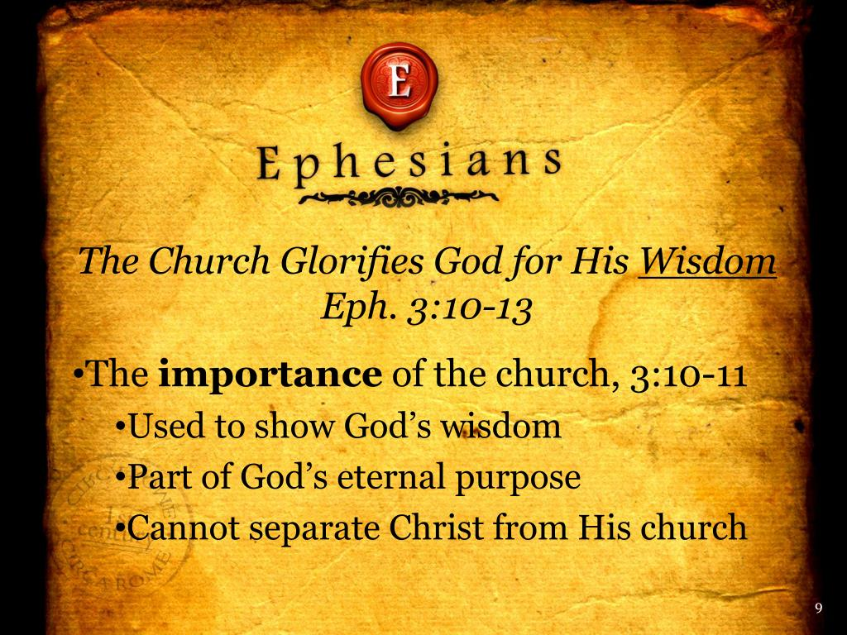

Slide 35



Slide 36
No Bible Study
Next Week – 8 June
Pastor and First Lady
at
Hampton Ministers’ Conference

Slide 37
NEXT CLASS – 15 June 2022
Book of Ephesians
Before next class, read the below verses in the NIV and in one other versions of the Bible, i.e., NKJV, NRSV, KJV, CEV, etc …
Chapter 3:14 – 21
“Paul on His Knees . . . Again”

